Slide 1

YouTube Statistics Analysis
BY: Ayaz Jamani

Slide 2
Top 10 YouTube channels based on the number of subscribers
Rank | Channel Name | Subscribers
1 | T-Series | 245,000,000
2 | YouTube Movies | 170,000,000
3 | MrBeast | 166,000,000
4 | Cocomelon - Nursery Rhymes | 162,000,000
5 | SET India | 159,000,000
6 | Music | 119,000,000
7 | Kids Diana Show | 112,000,000
8 | PewDiePie | 111,000,000
9 | Like Nastya | 106,000,000
10 | Vlad and Niki | 98,900,000

Slide 3
Category which has the highest average number of subscribers
Category | Average Subscribers
Shows | 41,615,380
The shows category has the highest average subscribers present in the given dataset.

Slide 4
Average number of videos uploaded by YouTube channels in each category?
Rank | Category | Average Uploads
1 | News & Politics | 112,484
2 | Nonprofits & Activism | 102,912
3 | Shows | 27,444
4 | Sports | 19,130
5 | Entertainment | 12,052
6 | People & Blogs | 9,257
7 | Trailers | 6,839
8 | Gaming | 4,285
9 | Pets & Animals | 3,563
10 | Movies | 3,553
11 | Education | 3,087
12 | Film & Animation | 2,862
13 | Music | 2,326
14 | Science & Technology | 2,114
15 | Howto & Style | 1,696
16 | Autos & Vehicles | 1,551
17 | Comedy | 1,203
18 | Travel & Events | 766

Slide 5
Top 5 countries with the highest number of YouTube channels
Rank | Country | Number of Channels
1 | United States | 315
2 | India | 169
3 | Brazil | 62
4 | United Kingdom | 44
5 | Mexico | 33
United States has the highest number of YouTube channels followed by India, Brazil, UK and Mexico.

Slide 6
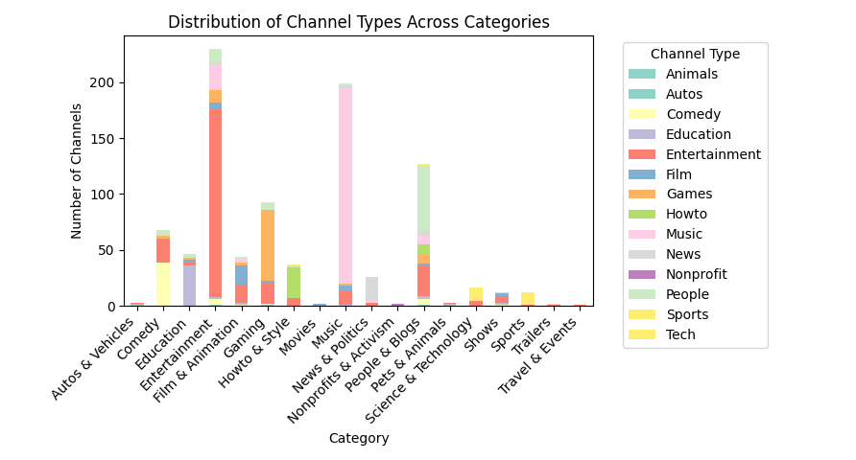
The distribution of channel types across different categories
Entertainment and Music categories have the highest number of channels.
The Entertainment category has a large and diverse mix of content such as Entertainment, Games, and Music.
Categories such as Nonprofits & Activism or Travel & Events have lower creator engagement, possibly indicating less competition or lower viewer demand.

Slide 7
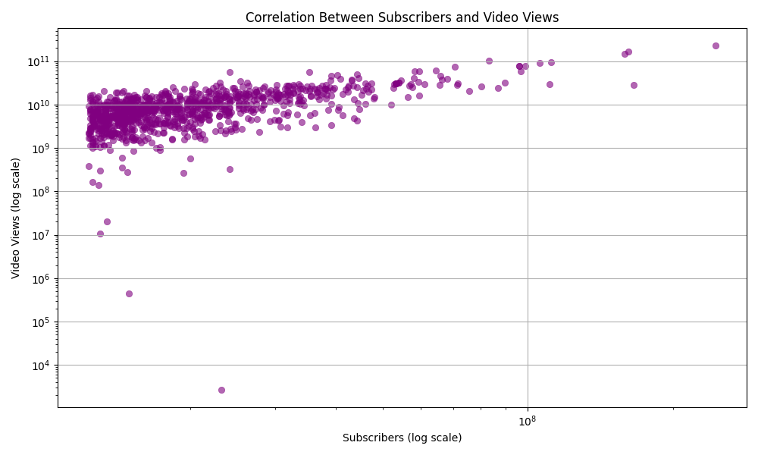
Correlation between subscribers and total views for YouTube channels
The Pearson correlation coefficient is 0.83, which indicates a strong positive correlation between the number of subscribers and total video views.
As the number of subscribers increases, the total number of video views tends to increase as well.

Slide 8
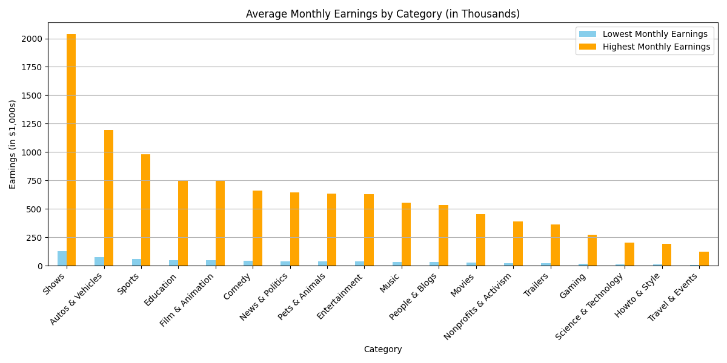
Monthly earnings throughout different categories
The bar chart compares the lowest and highest monthly earnings across different YouTube content categories, the blue bars represent the lowest earnings, and the orange bars represent the highest possible earnings within each category.
Shows dominate with the highest maximum monthly earnings, exceeding $2 million/month.
Travel & Events, HowTo & Style, and Science & Technology fall at the lower end of both minimum and maximum earnings.

Slide 9
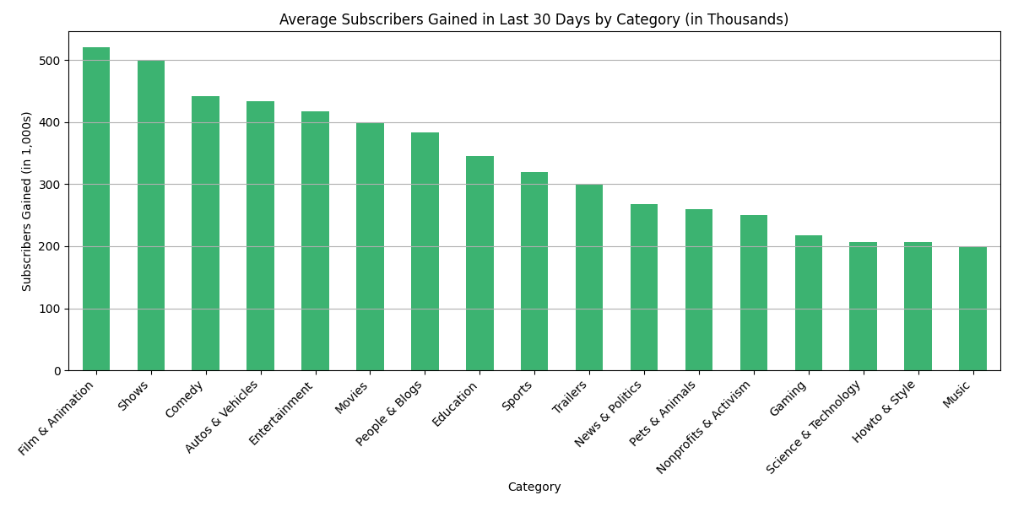
Overall trend in subscribers gained over the last 30 days across all channels
Film and Animation has the highest no. of subscribers gained in the last 30 days indicating a fairly large audience with potential to increase.
Music has the lowest no. of subscribers gained over the last 30 days.

Slide 10
Outliers in terms of yearly earnings from YouTube channels
YouTuber | Highest Yearly Earnings (USD)
KIMPRO | $163,400,000
DaFuq!?Boom! | $110,600,000
T-Series | $108,400,000
KL BRO Biju Rithvik | $97,600,000
Cocomelon - Nursery Rhymes | $94,800,000
The Weeknd | $17,900,000
News 24 | $17,800,000
SEVENGERS | $17,700,000
Susy Mouriz | $17,700,000
Tilak | $17,600,000
These are the top 10 channels with outliers in terms of yearly earnings compared to average yearly earnings.

Slide 11
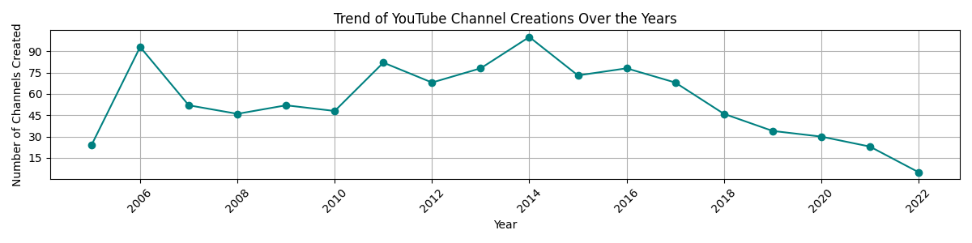
Distribution of channel creation dates and trends over time
A sharp rise in channel creations begins around 2005-06, aligning with YouTube’s launch and rapid early growth.
The graph peaks in 2014, with over 100 channels created
There’s a steady decline in new channel creation from 2017 onward, especially after 2019.
The number of new channels drops significantly in the last few years May reflect data incompleteness or real decline in major channel launches

Slide 12
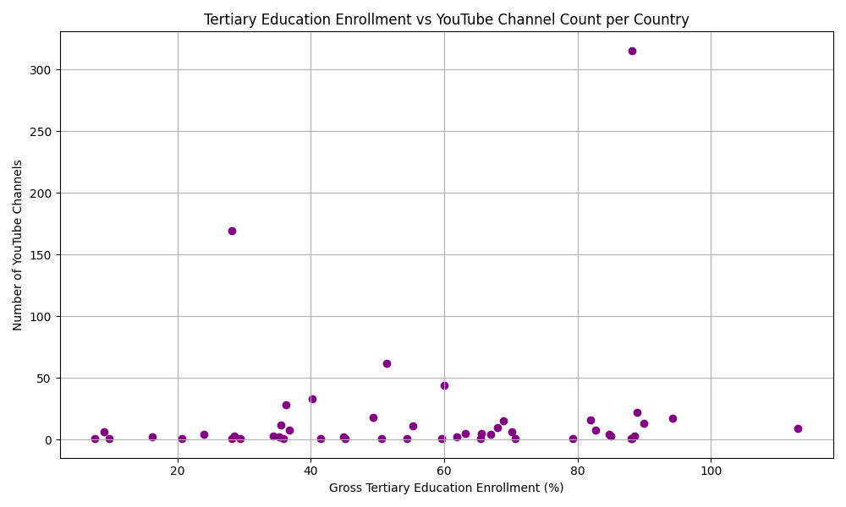
Relationship between gross tertiary education enrollment and the number of YouTube channels
The calculated correlation coefficient is only 0.11, which indicates a very weak positive relationship or a negligible relationship.
In practical terms, this means higher education enrollment does not strongly predict how many YouTube channels a country has.

Slide 13
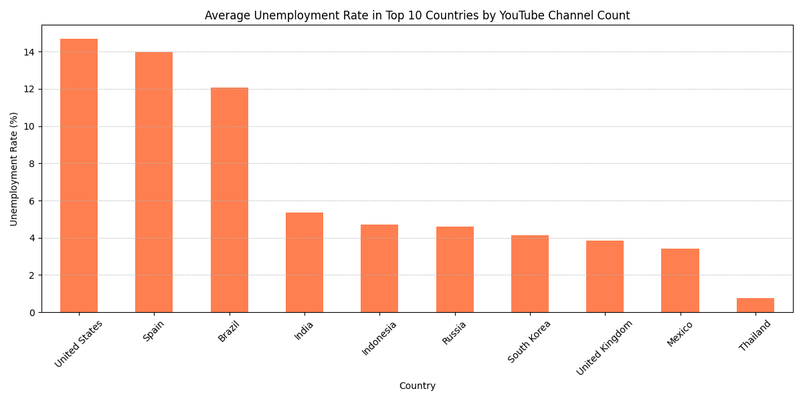
Unemployment rate among top 10 countries with the highest number of channels
There seems to be a mild association between higher unemployment and higher YouTube activity (in countries like the US, Spain, Brazil), it's not consistent across all top channel-producing countries.
This implies that YouTube is also an aspirational or entrepreneurial path in economically stable countries.

Slide 14
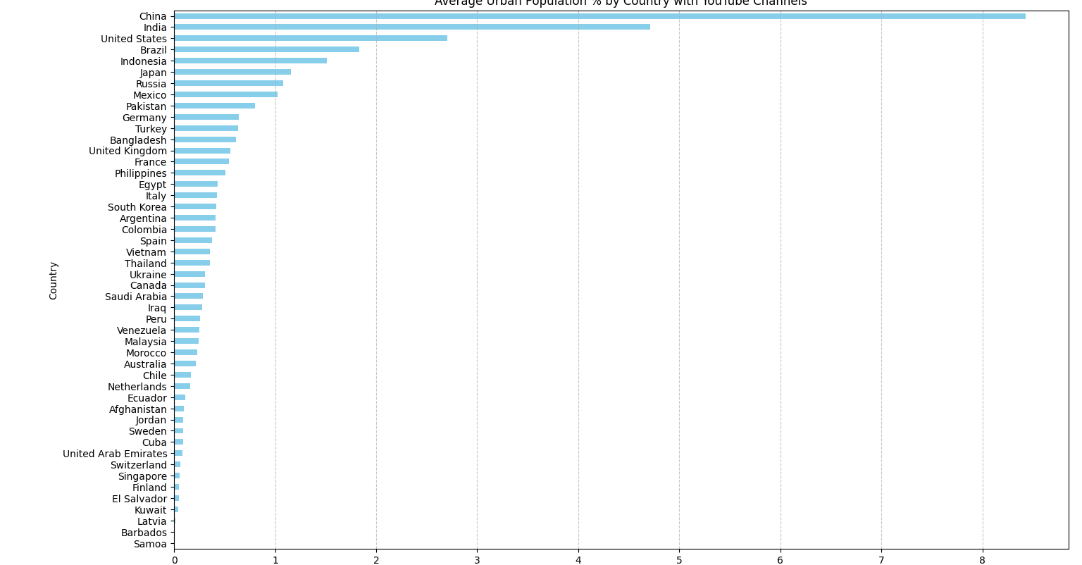
Average urban population percentage in countries with YouTube channels
China and India dominate due to their massive populations, not necessarily because of high urbanization rates.
High urbanization does not guarantee more YouTube channels since countries like Singapore, Switzerland, and UAE are highly urban but have fewer creators.
Urbanization alone isn't a strong predictor of YouTube activity instead population size, internet access, and creator economy play larger roles.

Slide 15
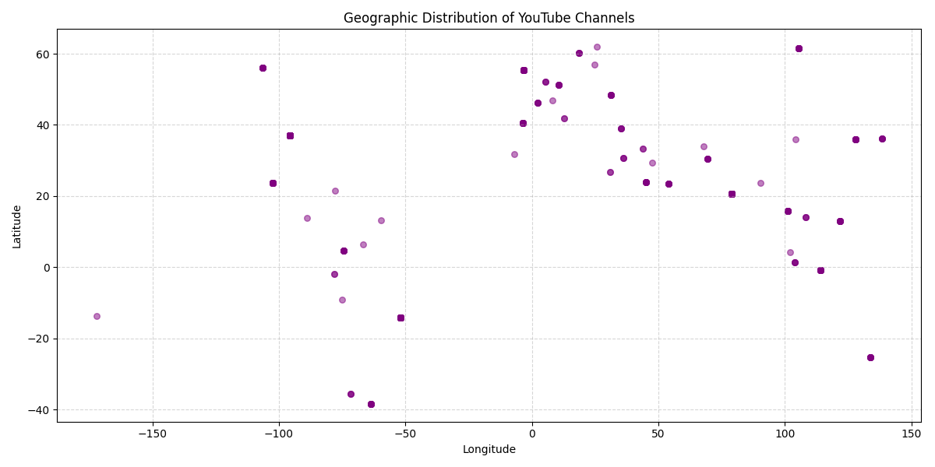
Patterns in the distribution of YouTube channels based on latitude and longitude
High concentration of channels in the Northern Hemisphere.
Clusters are visible across North America, Europe, South Asia, and East Asia, indicating these are major hubs for YouTube creators.
Sparse representation from Africa, Central Asia, and remote island regions, possibly due to limited access, infrastructure, or data availability.
Presence of channels in both developed and developing regions shows the democratization of content creation globally.

Slide 16
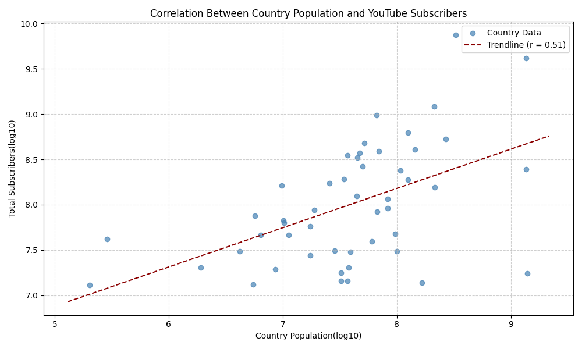
Correlation between the number of subscribers and the population of a country
The scatter plot shows a moderate positive correlation (r = 0.51) between a country's population size and its total YouTube subscribers.
Some countries with medium-sized populations have a high subscriber base, indicating other factors like internet access, language reach, and content culture play a role
Some countries with medium-sized populations have a high subscriber base, indicating other factors like internet access, language reach, and content culture play a role

Slide 17
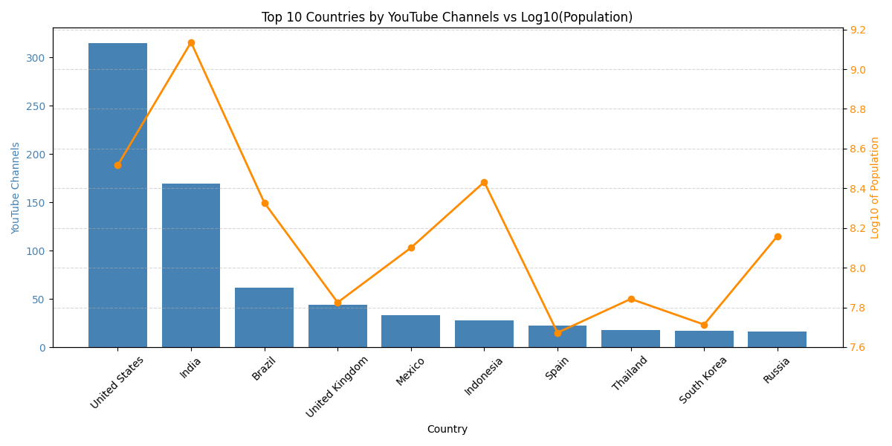
Comparison of Top 10 countries with YouTube channels in terms of population
The United States clearly leads by a significant margin in the number of YouTube channels
India has the highest population compared to all the other countries but still has significantly lower channels than the United States indicating that a higher population does not always equate to a higher channel count
Many different factors such as economic development, internet availability and digital literacy.

Slide 18
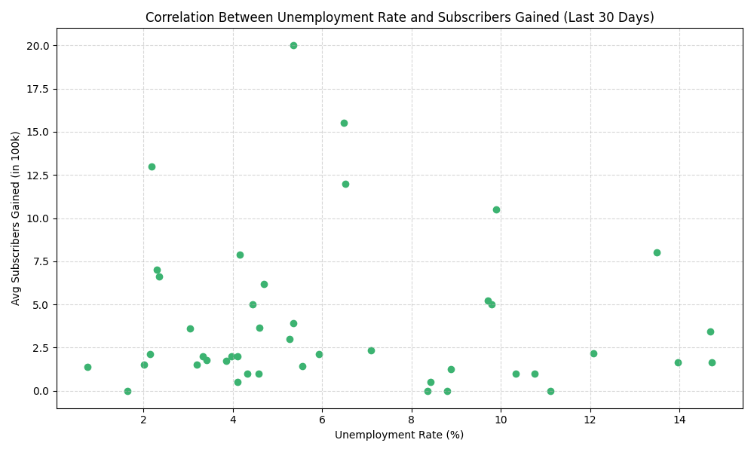
Correlation between subscribers gained in the last 30 days and unemployment rate in a country
The Pearson correlation coefficient of -0.06 indicates a very weak, almost negligible negative linear correlation between the unemployment rate and average subscribers gained.
The data points are widely scattered, confirming that there isn't a clear upward or downward trend. You cannot predict subscriber gains based on the unemployment rate (or vice versa) from this data.

Slide 19
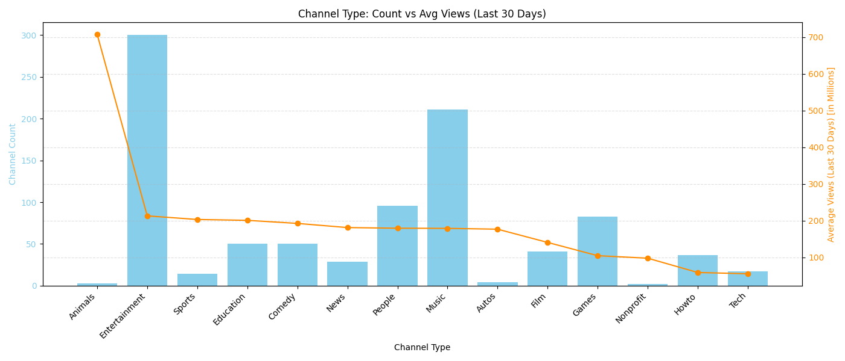
Distribution of views for the last 30 days across different channel types
The "Animals" channel type has an extremely low channel count, but has the highest average views by far (over 700 million).
Categories like Sports, Education, Comedy and News have lower channel counts but significantly higher views (approx. 200 million)
Based on the graph, there isn't a direct correlation where a higher channel count automatically means higher average views.

Slide 20
Distribution of views for the last 30 days across different channel types
The "Animals" channel type has an extremely low channel count, but has the highest average views by far (over 700 million).
Categories like Sports, Education, Comedy and News have lower channel counts but significantly higher views (approx. 200 million)
Based on the graph, there isn't a direct correlation where a higher channel count automatically means higher average views.

Slide 21
Are there any seasonal trends in the number of videos uploaded by YouTube channels?
We cannot indicate any particular trends in terms of seasons since there is not enough data available to display/calculate any trends

Slide 22
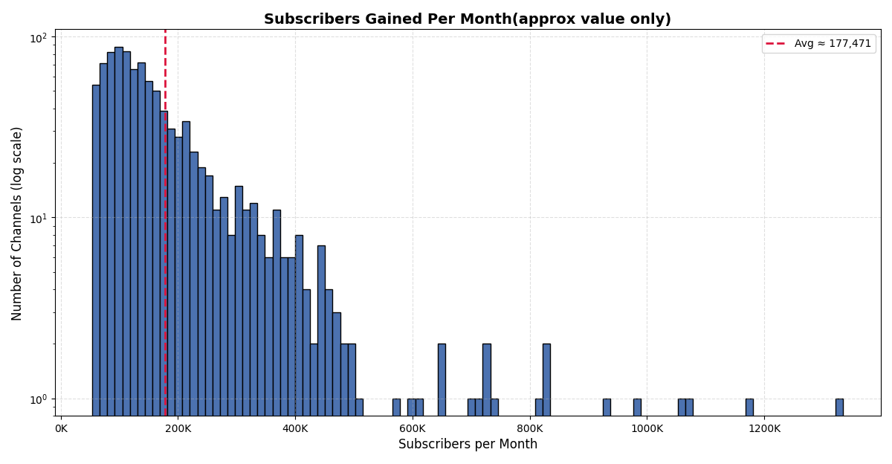
Average number of subscribers gained per month since the creation of YouTube channels
High Variability: There's a wide range in subscriber gains, from very few to over 1.2 million per month, highlighting the diverse performance of channels.
The average subscriber gain is approximately 177,471. The average is pulled up by a few high-performing channels.

Slide 23
Thank You

